Slide 1
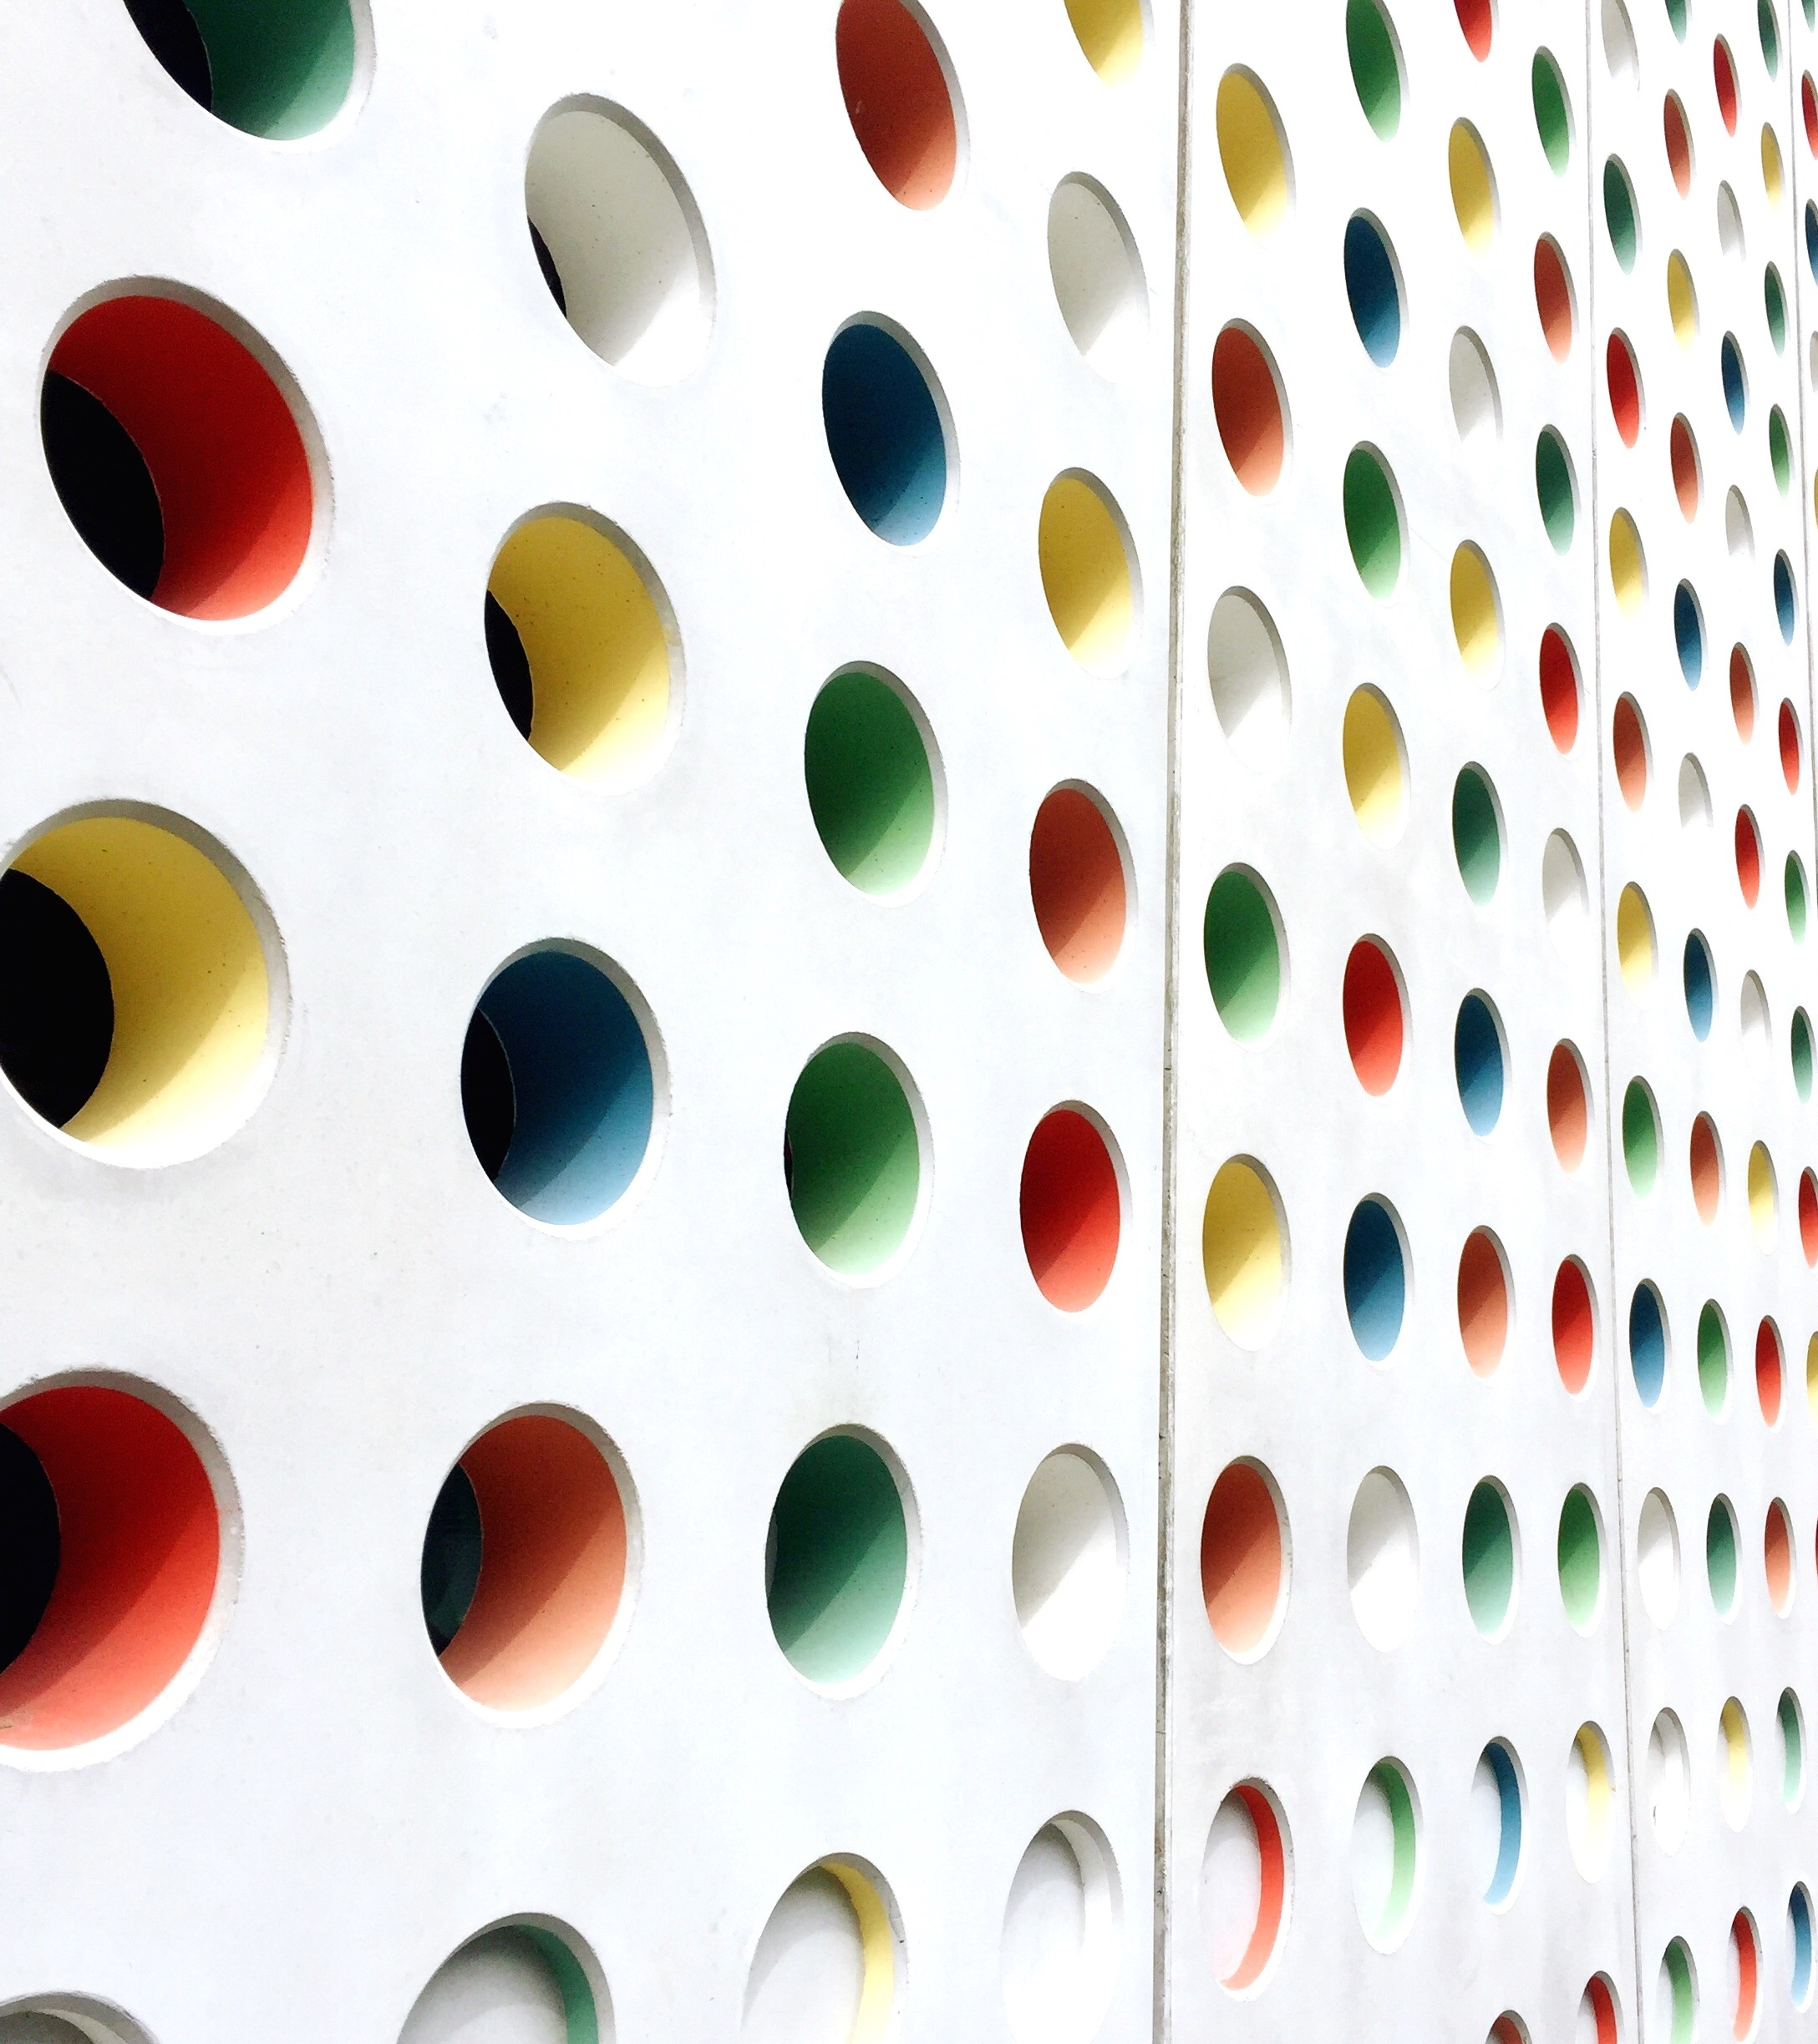
LED BLINKING CIRCUIT
IOT – PROJECT
presented by- UDAY

Slide 2
Smart Doorbell with Multi-LED Feedback
Practicality
Customizable
Visual Feedback

Slide 3
Objective
Create a circuit that functions as a smart doorbell, where pressing a push button triggers LEDs to blink in specific patterns to indicate different states (e.g., doorbell rung, system active, low battery warning). This system is useful for home entrance visitor alerts and provides visually appealing feedback.

Slide 4
Components Used:
❖Essential Components:
❖LED (Light Emitting Diode): The component that produces light when current flows
through it.
❖Resistor: Limits the current flowing through the LED, preventing it from burning out.
❖Power Source: Provides the electrical energy to operate the circuit (e.g., battery).
❖Jumper Wires: Connects the components on a breadboard or other prototyping
platform.

Slide 5
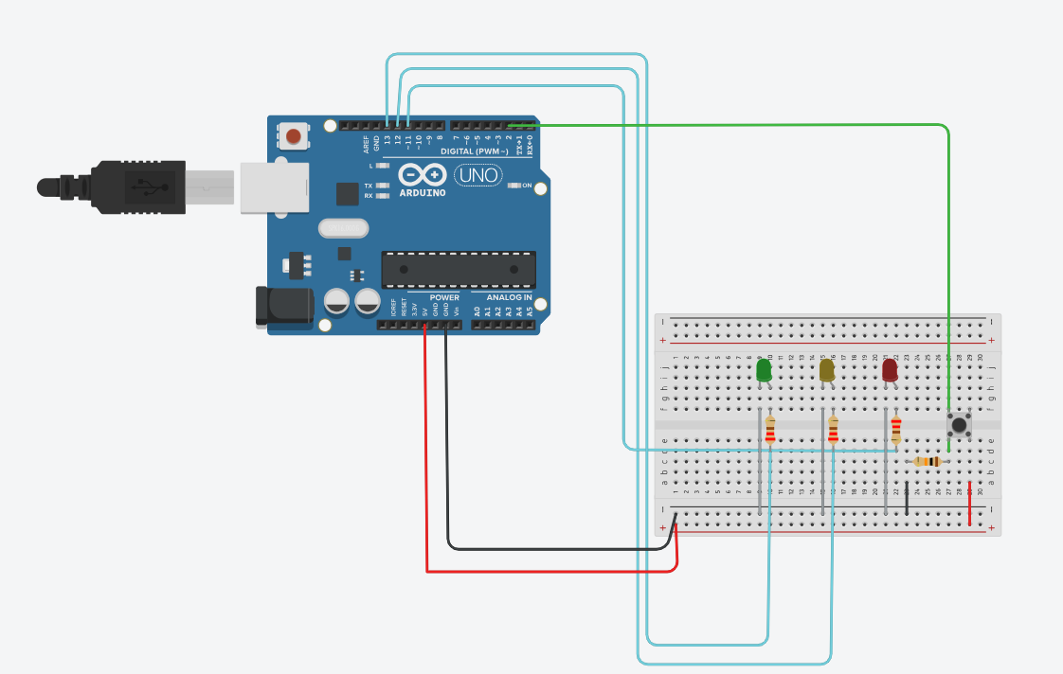
CIRCUIT DIAGRAM

Slide 6
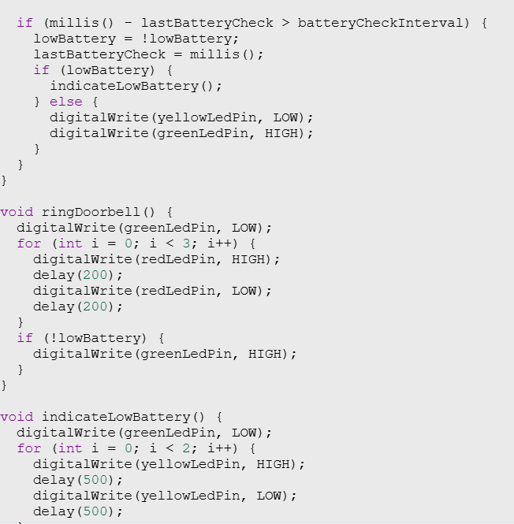
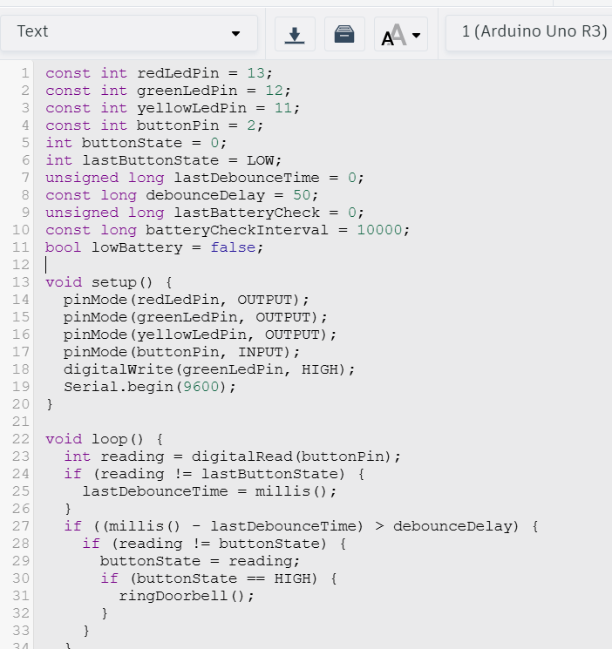
Code snippet

Slide 7
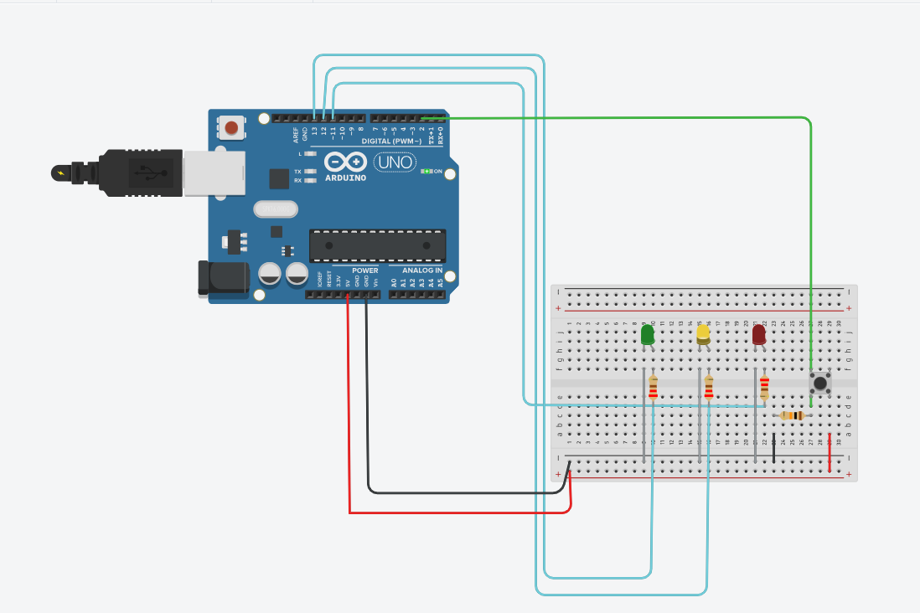
After Simulation

Slide 8
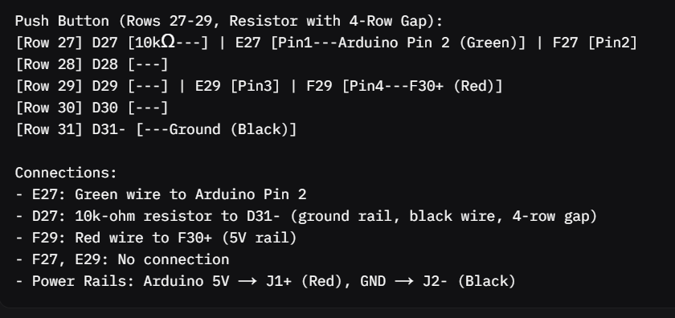
Visual Diagram
It shows the connections of circuit

Slide 9
Challenges and Solutions
Challenge: Incorrect Push Button Connections
Issue: Wrong pins used (e.g., F27/E29 instead of E27/F29) or F29 connected to resistor.
Solution: Connect E27 → Arduino Pin 2 (green wire), F29 → F30+ (red wire, 5V). Leave F27, E29 unused.
Challenge: Resistor Across Central Gap
Issue:10k-ohm resistor from D26 to D30 (across gap, 4-row gap), breaking pull-down circuit.
Solution: Delete resistor. Place new 10k-ohm resistor from D27 to D31- (left side, 4-row gap), connect D31- to ground rail (J2-, black wire).
Challenge: LEDs Not Blinking
Issue: Reversed LEDs or wrong resistor values.
Solution: Ensure anode (A1, A5, A9), cathode (B1, B5, B9). Use 220-ohm resistors. Check pins: 13 (Red), 12 (Green), 11 (Yellow).
Challenge: Button Not Responding
Issue: Incorrect pull-down resistor or code using INPUT_PULLUP.
Solution: Verify D27 → D31- (10k-ohm). Use code with pinMode(buttonPin, INPUT). Test button press in simulation.

Slide 10
Conclusion
The Smart Doorbell with LED Feedback System in Tinkercad, with a 4-pin push button (rows 27-29: F27, E27, F29, E29) and corrected 10k-ohm resistor (D27 to D31-, 4-row gap, left side to ground), successfully delivers visual feedback: Red LED (Pin 13, row 1) blinks 3 times for doorbell rung, Green LED (Pin 12, row 5) stays ON for system active, and Yellow LED (Pin 11, row 9) blinks twice every 10 seconds for low battery. Fixing your issues (resistor across D26-D30, F29 to resistor), the circuit is reliable for home, office, accessibility, and educational use. Challenges like incorrect wiring and resistor placement were resolved with clear connections and code using INPUT

